Slide 1


REGRESSION ANALYSIS PREDICTION OF INSURANCE PREMIUM
Under the guidance:
Dr.Aakansha Gupta
By : Arjun Maurya

Slide 2
INTRODUCTION
Insurance premium is the amount of money a person/business pays for an insurance policy that covers various types of insurances example health, vehicle, home, etc.
Premiums are paid in time periods, depending upon the terms and conditions .
There are various factors on which the premium amount depends. The premium amount might change depending upon these factors.
OBJECTIVE
To build a regression models to predict insurance premium .
Compare different regression models and find the best model using performance evaluation measures.

Slide 3
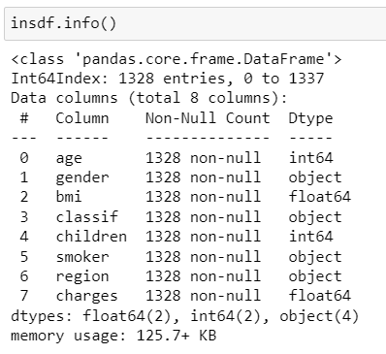
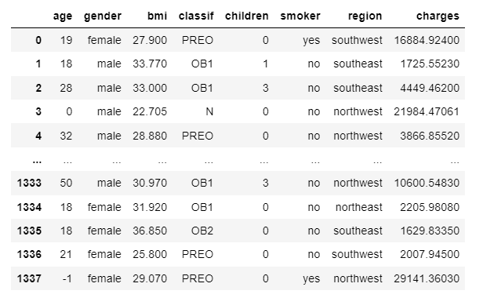
DATA COLLECTION
Imported required libraries.
Read the data to a DataFrame.
1338 rows and 8 Columns .

Slide 4
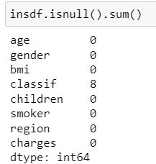
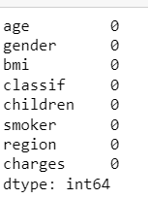
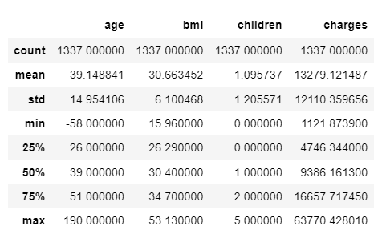
DATA EXPLORATION
Handling missing values
Handling duplicates data.
A statistical description of each continuous column is shown.

Slide 5
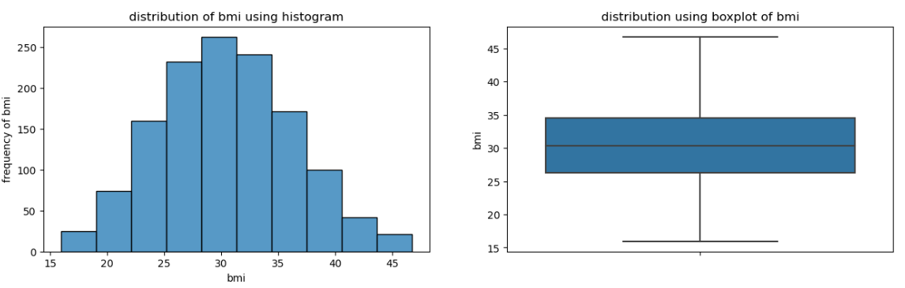
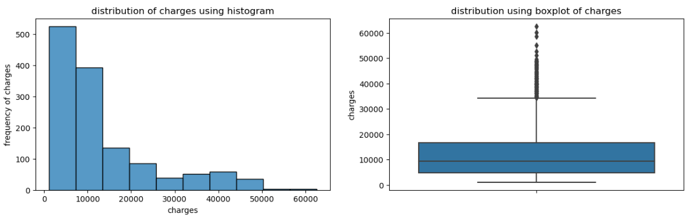
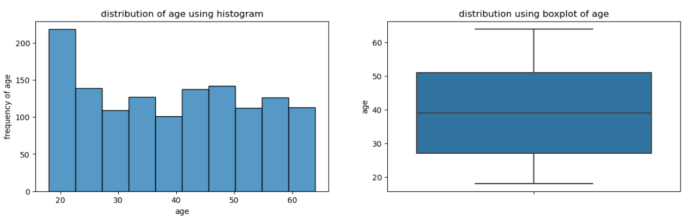
EXPLORATORY DATA ANALYSIS
Bmi shows normal distribution.
Charges shows outliers
Age is normally distributed .

Slide 6
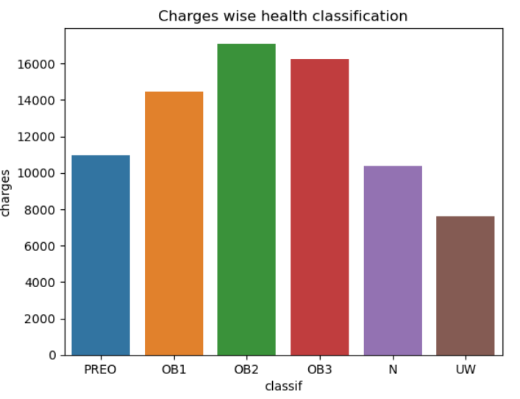
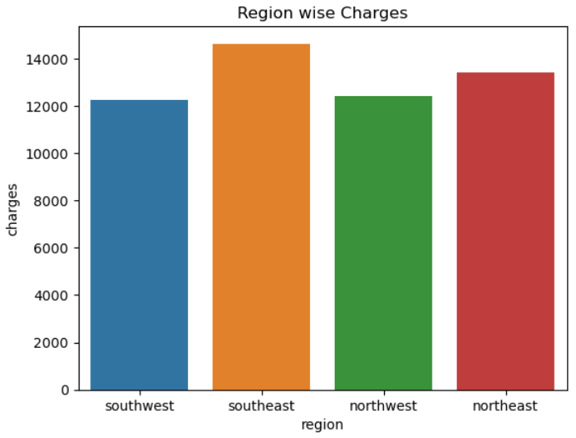
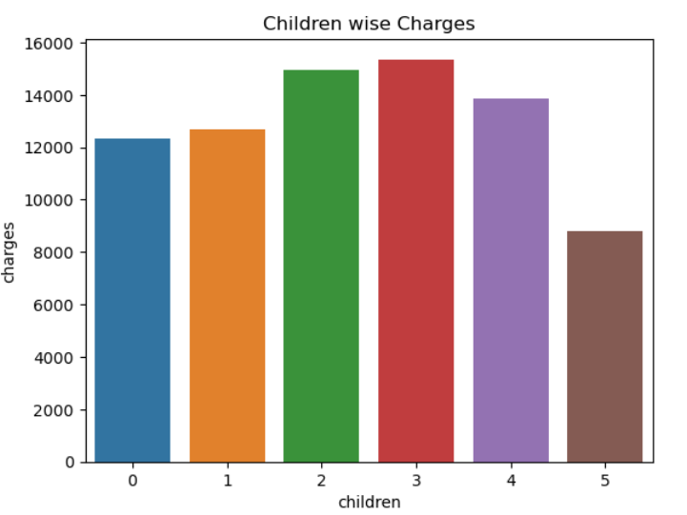
Most of the Customers are of young age .
Most of the customers belong to health class of PERO.
Customers having class OB2 are charged more.
Customers having two to three children are charged more than customers having a single child or having most children.
Customers belonging to the South East region are charged more.

Slide 7
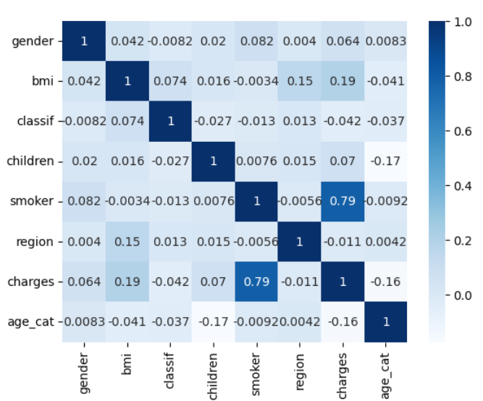
DATA PREPROCESSING
Changing the datatype of object to Category
Label Encoding
Feature Scaling
Splitting Dataset for training and testing
Correlation Matrix

Slide 8

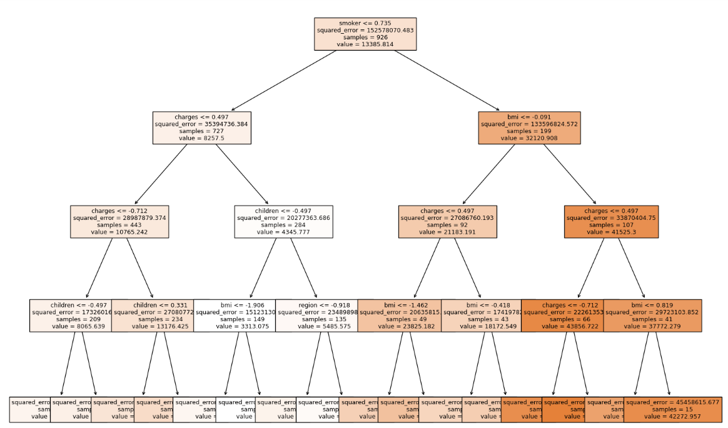
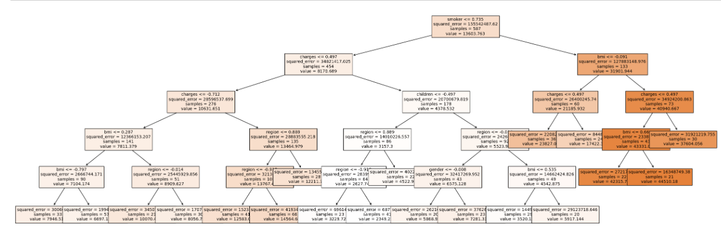
REGRESSION MODELS USED
The Machine Learning Regression Models used in this project are:
Linear Regression
Decision Tree Regression
Random Forest Regression
KNN Regressor
Stacking

Slide 9
MODELS COMPARISON
Performance Evaluator | LINEAR REGRESSION | DECISION TREE REGRESSION | RANDOM FOREST REGRESSOR | STACKING REGRESSOR | KNN REGRESSOR
TEST | 0.6407 | 0.8292 | 0.3794 | 0.8567 | 0.772
TRAIN | 0.695 | 0.8779 | 0.3778 | 0.8714 | 0.822
R2 | 0.644 | 0.820 | 0.3794 | 0.823 | 0.772
RMSE | 6850.24 | 4852.36 | 9021.29 | 4892.20 | 5466.407
MAE | 5146.19 | 2847.60 | 6794.35 | 2776.57 | 3722.67
MAPE | 0.5721 | 0.2878 | 1.17408 | 0.28984 | 0.4563

Slide 10
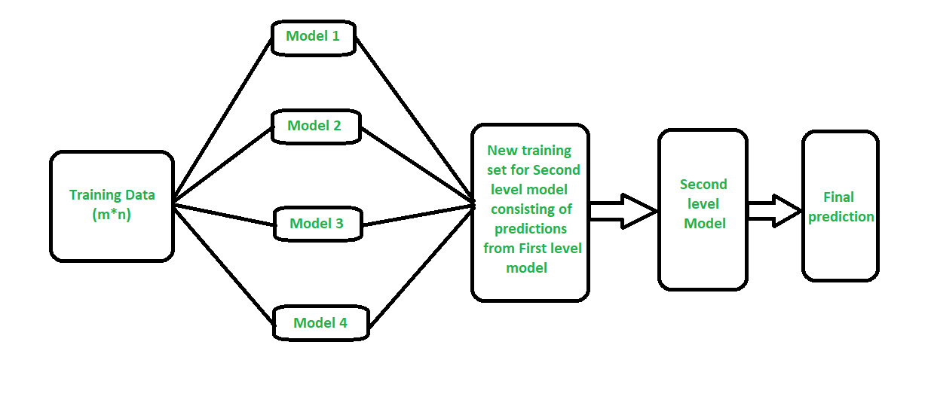
CONCLUSION
‘Stacking’ regressor machine learning model is the best model in this regression type problem.
A new dataset can be passed , there is 87% chance that it will give an accurate result .

Slide 11


